Slide 1
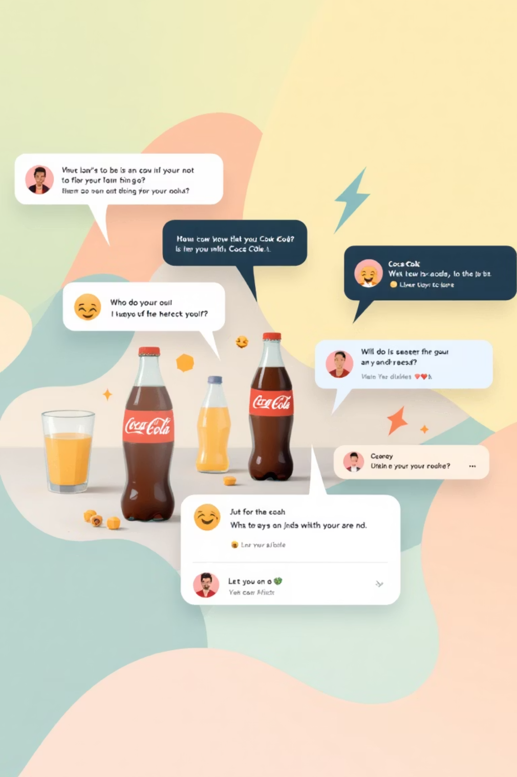
Sentiment Analysis for Brand Monitoring: Coca-Cola Social Media
This presentation details a project focused on leveraging Natural Language Processing (NLP) to classify social media comments about Coca-Cola. Our goal is to automatically categorize feedback into positive, neutral, or negative sentiment, providing invaluable insights for brand monitoring and strategic decision-making.

Slide 2

Presentation Overview & Background
What This Presentation Covers:
This presentation explores sentiment analysis of Coca-Cola social media comments using advanced semantic embeddings and machine learning models to classify user sentiment into Negative, Neutral, and Positive categories.
Why Sentiment Analysis Matters:
Brand Monitoring
Competitive Advantage
Limitations of Traditional Methods
Companies track social media sentiment to understand customer perception and respond to feedback in real-time.
Sentiment insights reveal market trends and customer preferences faster than traditional surveys.
TF-IDF and bag-of-words approaches miss semantic meaning; Universal Sentence Encoder captures deeper contextual understanding.
Presentation Roadmap:
Dataset Overview & Preprocessing
Semantic Embeddings with Universal Sentence Encoder (USE)
Model Architecture & Integration
Model Performance & Evaluation
Visualization: Confusion Matrix & ROC Curves
Final Model Selection
Limitations & Future Work
References & Acknowledgements

Slide 3

Project Overview: Classifying Coca-Cola Social Media Sentiment
1
Project Scope
Analyzed social media comments related to Coca-Cola, aiming for automated sentiment classification.
2
Core Objective
Developed a system to accurately classify comments into Positive, Neutral, or Negative sentiment categories.
3
Methodology
Utilized a robust pipeline: preprocessing, Universal Sentence Encoder (USE) for embeddings, and advanced ML models like ExtraTrees, CatBoost, and Logistic Regression.
4
Performance
Achieved an impressive accuracy of up to 88.88%, demonstrating the effectiveness of our chosen approach.

Slide 4

Dataset and Preprocessing for Robust Analysis
Our analysis was built upon the complete_data.csv dataset, specifically curated for Coca-Cola comment data. This dataset provided the essential raw material for training and evaluating our sentiment models.
Key Data Components:
Text Column: Contains the raw user comments, the primary input for sentiment classification.
Label Column: Encodes the sentiment as 'positive', 'neutral', or 'negative', serving as the ground truth for model training.
Rigorous Preprocessing Steps:
Lowercasing: Standardized text to reduce vocabulary size and treat words uniformly.
Removal of URLs, Mentions, Special Symbols: Eliminated irrelevant noise that does not contribute to sentiment.
Whitespace and Noise Cleaning: Further refined text to ensure data quality and consistency.
Label Encoding: Converted categorical labels into numerical format (0, 1, 2) for compatibility with machine learning algorithms.

Slide 5










The Power of Semantic Embeddings with Universal Sentence Encoder (USE)
Instead of traditional bag-of-words or TF-IDF approaches, we harnessed the power of Universal Sentence Encoder (USE) to transform raw text into rich, semantic embeddings. This advanced technique is crucial for capturing the nuanced meaning of social media comments.
Sentiment Tone Detection
Contextual Understanding
It inherently understands the emotional and subjective tone within comments, critical for accurate sentiment classification.
USE generates 512-dimensional vectors that capture the deeper context and meaning of entire sentences, not just individual words.
Zero-Shot Capability
No additional training is required, making it efficient and ready for immediate application to our dataset.
Optimized for Short Text
It performs exceptionally well on concise social media comments, where traditional NLP methods might struggle with sparsity.
Efficiency and Speed
The model is lightweight, ensuring fast processing, which is essential for handling large volumes of social media data.
These robust embeddings serve as the direct input to our machine learning models, significantly enhancing their ability to discern complex sentiment patterns.

Slide 6
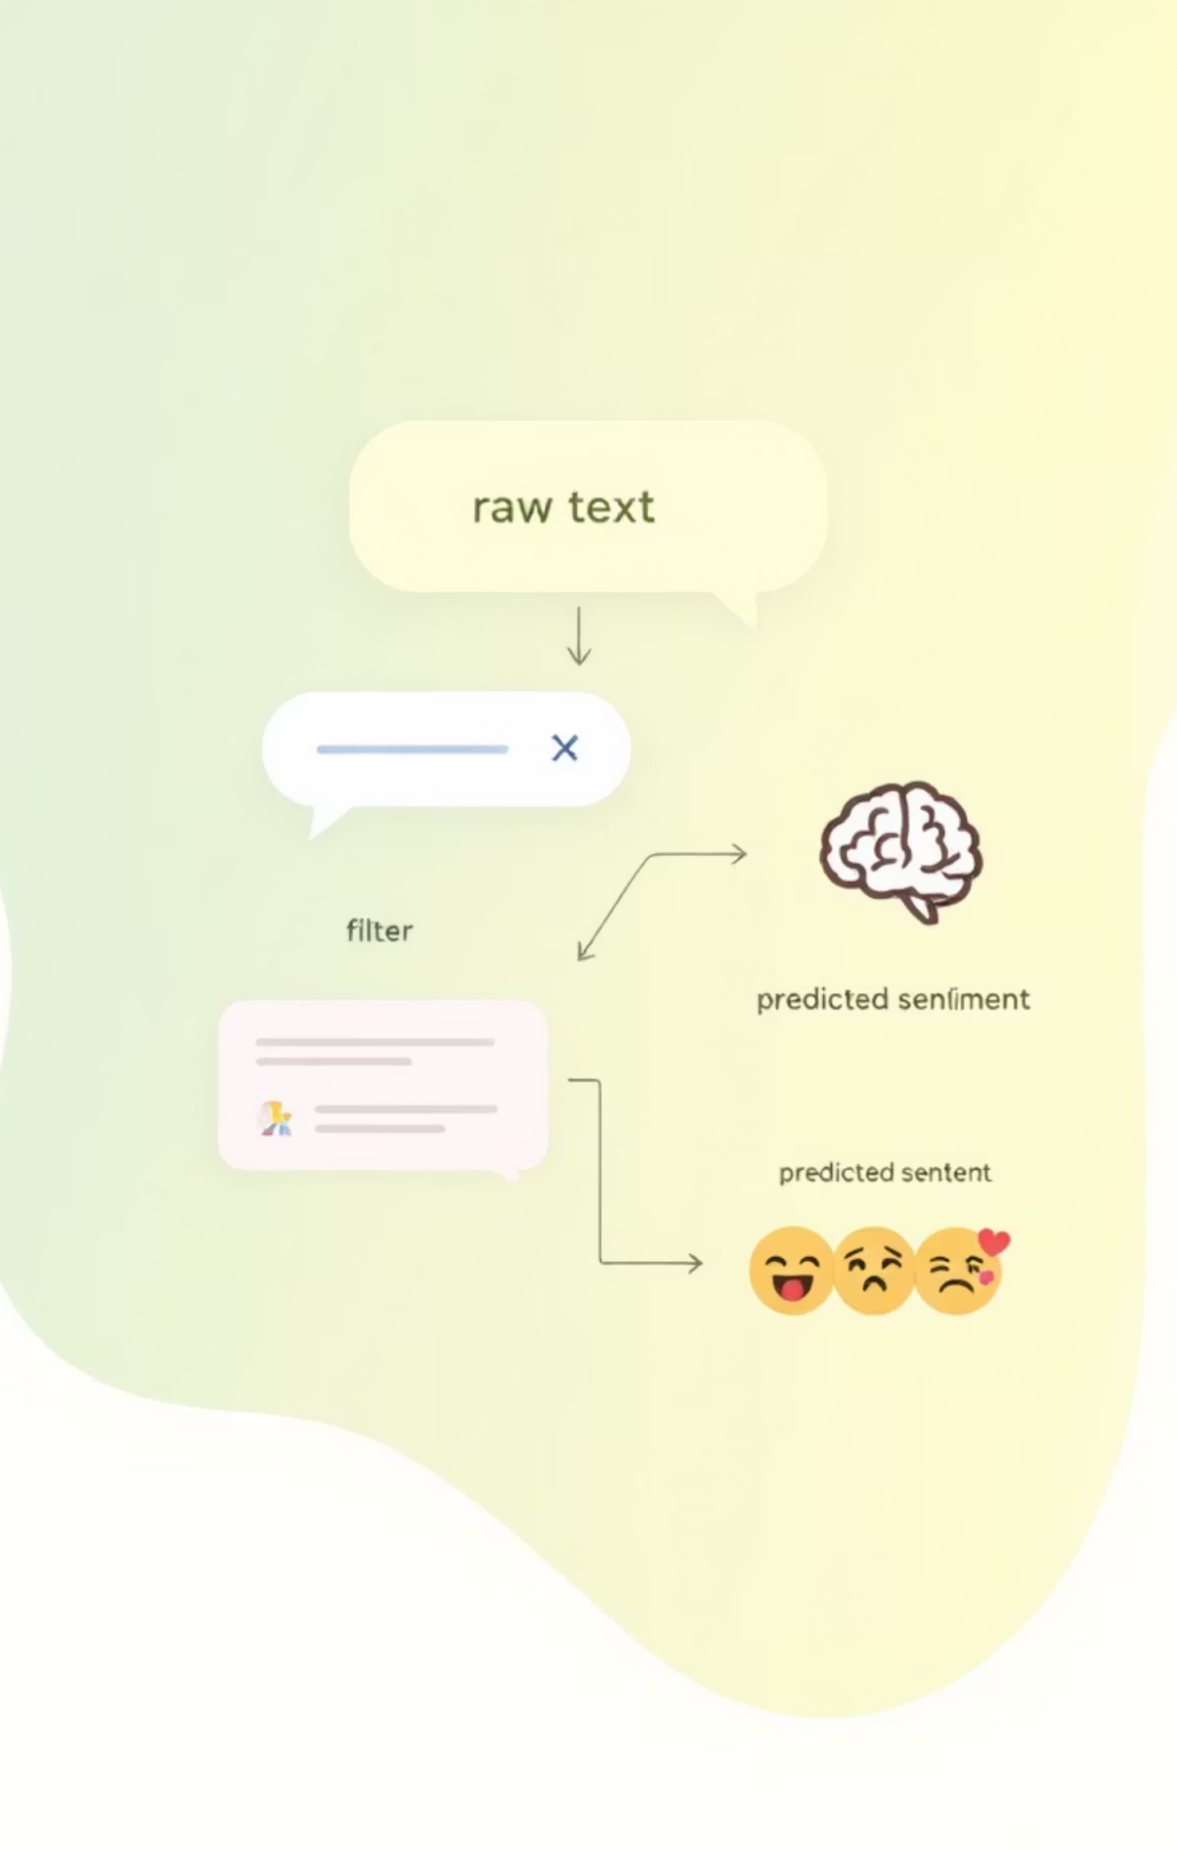





Integrated Model Architecture for Sentiment Prediction
Our sentiment analysis pipeline is designed for efficiency and accuracy, integrating preprocessing, semantic embedding, and advanced machine learning for robust sentiment prediction.
USE Embedding
Input Text
Raw user sentences
512-dim semantic vector
Text Preprocessing
Model Training
Clean and normalize text
ExtraTrees / CatBoost / LR
Data Split Strategy
The dataset was meticulously divided: 60% for Training to teach the models, and 40% for Testing to rigorously evaluate their performance on unseen data, ensuring generalization.
Multi-Class Classification
Our system addresses a multi-class problem, classifying sentiment into three distinct categories: 0 = Negative, 1 = Neutral, and 2 = Positive.

Slide 7



Advanced Machine Learning Models for Classification
To ensure comprehensive sentiment classification, we employed a suite of high-performance machine learning models, each selected for its unique strengths in handling complex data patterns.
ExtraTrees Classifier
CatBoost Classifier
Logistic Regression
This ensemble method constructs multiple randomized decision trees, providing high stability and robustness against overfitting. It excels in capturing intricate relationships within the data.
Known for its ability to handle categorical features and its robust performance, CatBoost is particularly effective with smaller datasets and complex patterns, ensuring high accuracy.
A powerful and interpretable linear classifier that provides a solid baseline. Its simplicity makes it easy to understand feature importance and model decisions.
All models were trained exclusively using the 512-dimensional semantic embeddings generated by the Universal Sentence Encoder, ensuring they benefited from the rich contextual information.

Slide 8
Superior Model Performance: Accuracy Scores
Our rigorous evaluation revealed exceptional performance across all models when combined with Universal Sentence Encoder (USE) embeddings, significantly enhancing classification accuracy.
ExtraTrees + USE
88.88%
CatBoost + USE
88.88%
Logistic Regression + USE
87.65%
The results clearly demonstrate that USE embeddings are instrumental in boosting the predictive power of our models. Both ExtraTrees and CatBoost achieved the highest accuracy, showcasing their effectiveness in discerning complex sentiment patterns from semantic representations.

Slide 9
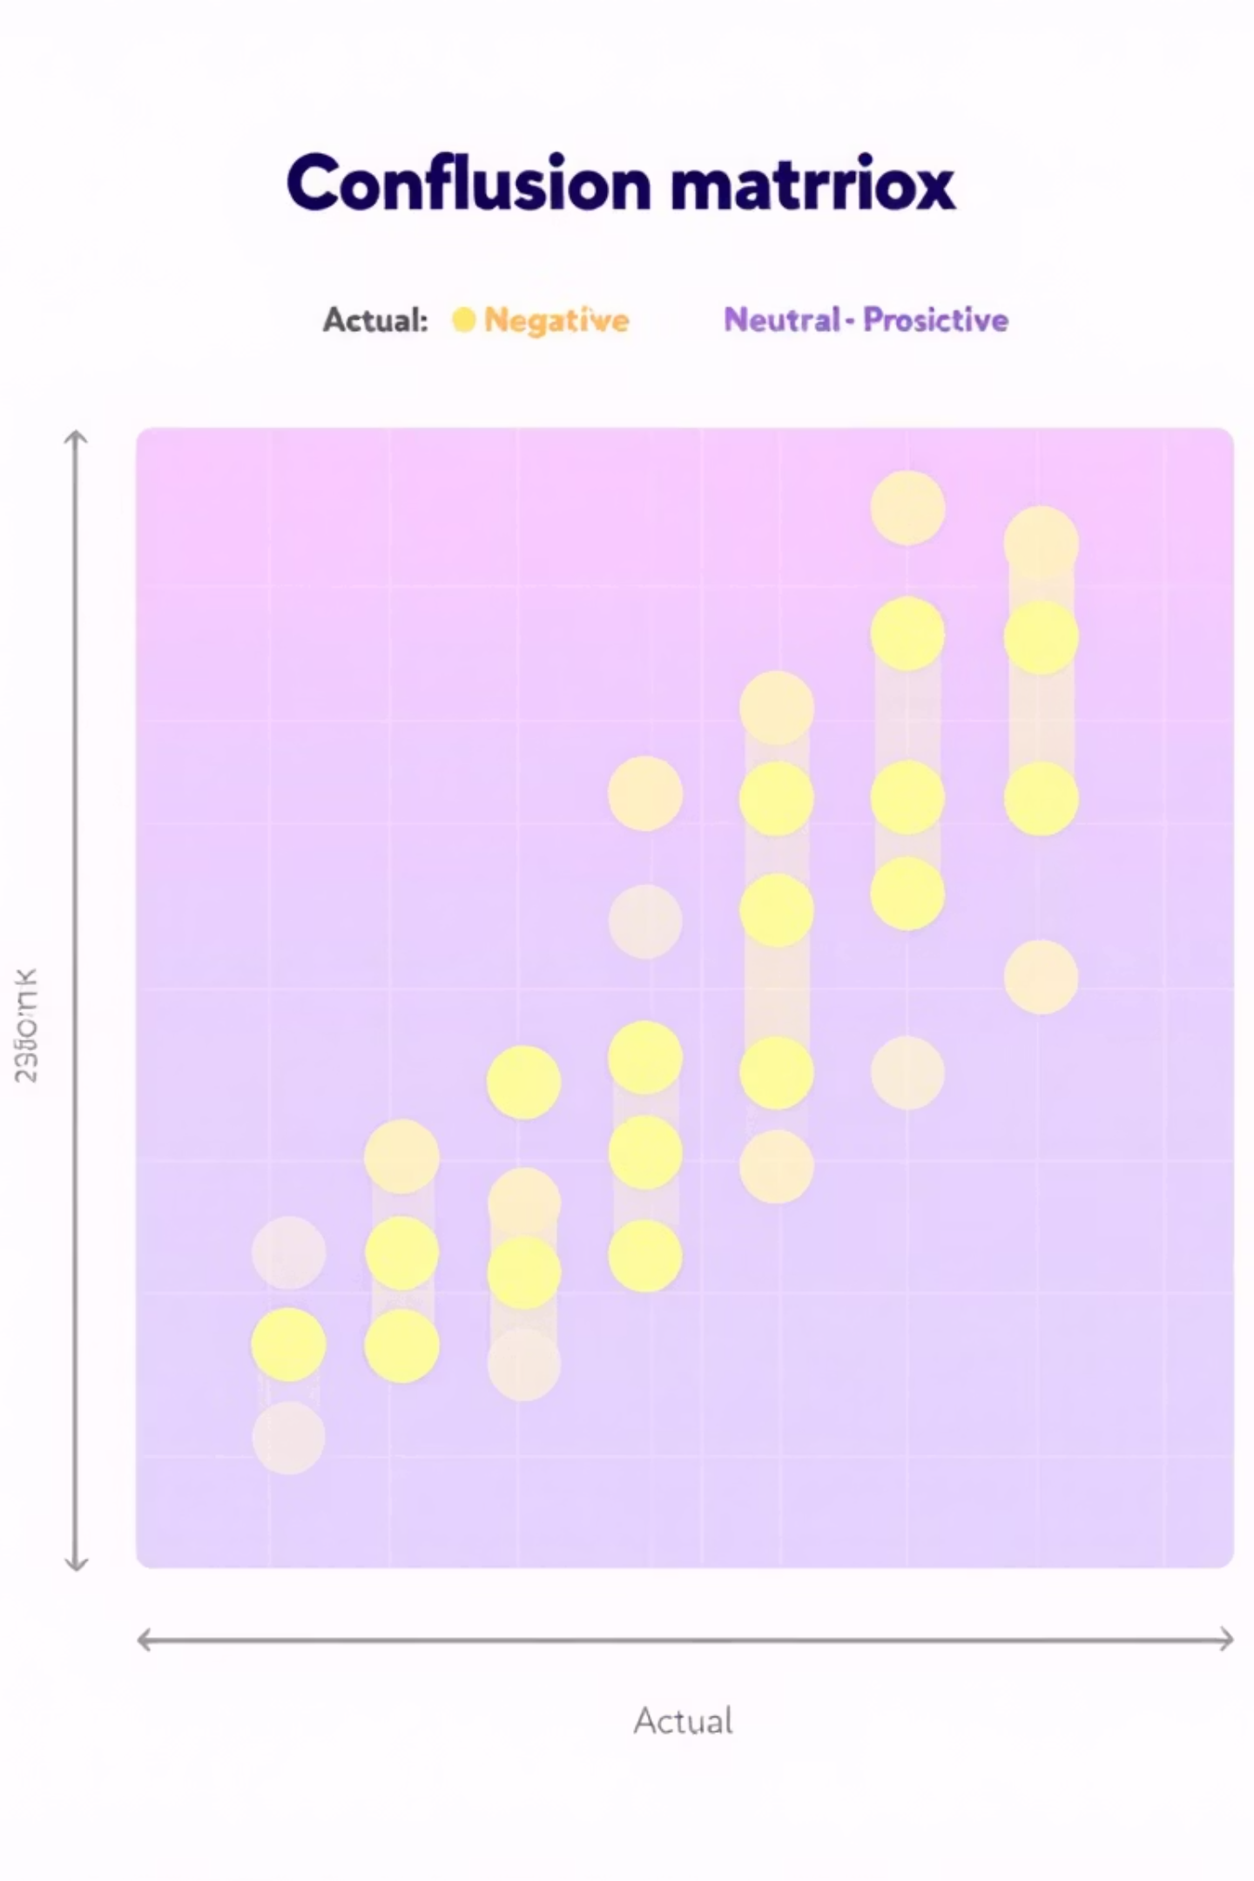
Confusion Matrix: ExtraTrees + USE
The confusion matrix provides a detailed view of our ExtraTrees + USE model's performance, showcasing its ability to correctly classify each sentiment category (Negative, Neutral, Positive) and highlighting any misclassifications.
Positive Sentiment: The model demonstrates strong accuracy in identifying positive comments, with a high number of true positives.
Neutral Sentiment: It also performs well in distinguishing neutral comments, crucial for separating them from strong positive or negative expressions.
Negative Sentiment: The model effectively detects negative sentiment, which is critical for proactive brand management.
This balanced performance across classes underscores the model's robustness and reliability for sentiment monitoring.

Slide 10
ROC Curve & AUC: Evaluating Multi-Class Performance
Beyond simple accuracy, the Receiver Operating Characteristic (ROC) curve and Area Under the Curve (AUC) provide a deeper understanding of our model's discriminative power across all sentiment classes, particularly in a multi-class context using a One-vs-Rest (OvR) approach.
One-vs-Rest Approach: We generate an ROC curve for each class against all other classes combined, offering insights into individual class separability.
Strong Class Separability: High AUC values across all curves indicate that our model effectively distinguishes between sentiment categories.
High Sensitivity & Specificity: The curves demonstrate that the model maintains a high true positive rate while keeping the false positive rate low, signifying strong predictive capabilities.
This comprehensive evaluation confirms the model's robust performance, extending beyond overall accuracy to detailed class-specific discrimination.

Slide 11
Limitations of the Project and Model
Limited Dataset Size
Noisy Social Media Text
A smaller dataset may affect model generalization to unseen data and real-world scenarios.
Social media comments are informal, unstructured, and often contain typos, slang, and grammatical errors that complicate analysis.
Sarcasm & Ambiguity
Emojis & Multilingual Content
Sarcastic comments and ambiguous language are difficult to classify correctly without additional context or domain expertise.
Emojis and multilingual comments are not fully addressed, potentially leading to misclassification of sentiment.
Domain-Specific Fine-tuning
Real-World Performance Variance
Universal Sentence Encoder is not fine-tuned for Coca-Cola or beverage industry sentiment, which may miss domain-specific sentiment cues.
Model accuracy may vary with real-world data due to evolving language use, new slang, and shifting social media trends.

Slide 12
Final Model Selection and Future Directions
Based on rigorous evaluation and performance metrics, we have selected the optimal model for production-level sentiment monitoring of Coca-Cola social media comments.
Chosen Model: ExtraTrees + USE
Highest Accuracy: Achieved an impressive 88.88% accuracy, demonstrating superior predictive power.
Consistent & Robust: Provided stable and reliable results, proving resilient to noise in social media data.
Fast Prediction: Offers efficient classification, crucial for real-time brand monitoring.
Synergistic with USE: The ExtraTrees classifier harmonizes exceptionally well with semantic embeddings, maximizing their potential.
This model is ideally suited for deployment, offering a powerful tool for analyzing brand perception.
Future Enhancements
Expanded Dataset
Advanced Nuance Detection
Integrate a larger and more diverse dataset to further improve generalization and cover broader nuances in language.
Incorporate capabilities for detecting complex linguistic elements like emojis and sarcasm, which are prevalent in social media.
Multilingual Support
Web Application Deployment
Extend the system to analyze comments in multiple languages, reflecting Coca-Cola's global presence.
Develop a user-friendly web application using Flask or Streamlit for easy access and real-time insights for stakeholders.

Slide 13
Acknowledgements
We extend our gratitude to our faculty advisor and instructor for their invaluable guidance, feedback, and support throughout this project.
Special thanks to our project teammates for their collaboration, insights, and contributions to this sentiment analysis initiative.
Tools & Technologies:
Google Colab - Cloud-based development environment
Python - Programming language for data science
Gamma AI - Presentation and documentation platform
scikit-learn - Machine learning library
TensorFlow Hub - Pre-trained models and embeddings
We appreciate the opportunity to present this work and welcome feedback for future improvements and refinements.

Slide 14
References & Technologies
Core Technologies:
Universal Sentence Encoder (Google Research) - Semantic embedding framework for text representation
scikit-learn Machine Learning Library - Comprehensive ML toolkit for model implementation and evaluation
CatBoost Documentation (Yandex) - Gradient boosting framework for classification tasks
ExtraTrees Classifier - Ensemble methods for robust sentiment classification
Research & Literature:
Semantic Embeddings and Transfer Learning in NLP - Foundation for USE-based approaches
Sentiment Analysis in Social Media - Domain-specific analysis methodologies
Multi-class Classification Evaluation Metrics - ROC curves, confusion matrices, and AUC analysis
Dataset:
complete_data.csv - Coca-Cola social media comment dataset with sentiment labels

